Slide 1



From analysis to action: data as a lever
for more independent regulation
Katharina Ledermann-Tappeiner Concurrent session 1b 22/10/2026

Slide 2






Different approaches
legal basis
PS-RIQ, Küfeoğlu, S.
(2026)
de facto
compliance

Slide 3
Different approaches
analysis
PS-RIQ, Küfeoğlu, S.
(2026)
recommendations

Slide 4
Different approaches
aggregate
PS-RIQ, Küfeoğlu, S.
(2026)
individual

Slide 5
What do regulators need?
Regulators that want to improve their independence need recommendations tailored to their individual situation and a comparative analysis with the aggregate regulator collective referring to their de iure, compliance and de facto situation.

Slide 6

CEER’s approach

Slide 7
CEER’s approach
Modules
Competences
Core principles
Staff
Management
Budget and financing
Accountability and transparency
Instructions and decision-making
only for regulators from partner organisations
peer group chosen freely
no need to answer all modules
average of 10 questions per module
drop-down / multiple choice and option for comments
takes about 20 minutes
gives immediate results

Slide 8
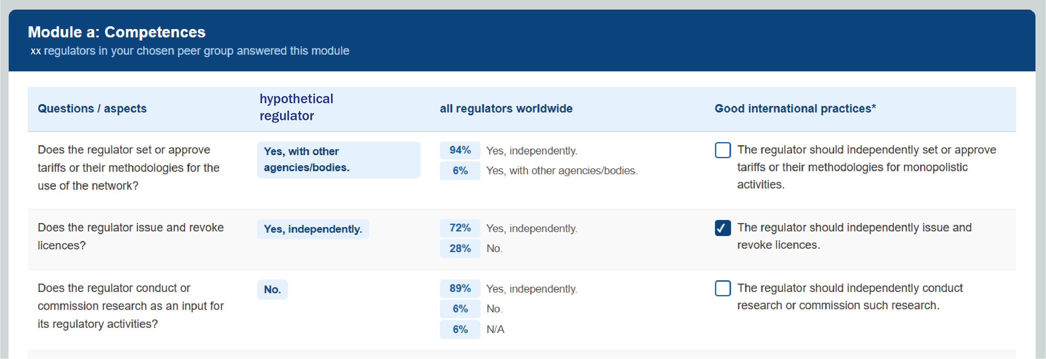
CEER’s approach
hypothetical answer
Want to know more? brussels@ceer.eu

Slide 9
From analysis to action:
data as a lever
for more independent regulation

